Slide 1
“Teach A Level Maths”
Statistics 1
Binomial Problems
© Christine Crisp

Slide 2
Statistics 1
AQA
MEI/OCR
OCR
"Certain images and/or photos on this presentation are the copyrighted property of JupiterImages and are being used with permission under license. These images and/or photos may not be copied or downloaded without permission from JupiterImages"

Slide 3
It’s important to be able to recognize when the Binomial Distribution can be used to solve problems and then to be able to structure the solution to avoid mistakes.
In this presentation we’ll look at some problems, see why the Binomial is a reasonable model and produce some rules for setting out the solutions.

Slide 4
e.g. 1. A factory produces a particular type of computer chip. Over a long period the number that are defective has been found to be 15%. What is the probability that in a sample of 20 taken at random, 19 are perfect?
Are the conditions met for using the Binomial model?
A trial has 2 possible outcomes, success and failure.
Yes: Each chip is either defective or not.
The trial is repeated n times.
Yes: 20 chips are selected so n = 20.
The probability of success in one trial is p and p is constant for all the trials.
Yes: We are given 15% ( from which we can find p ) and we can assume it is constant.
The trials are independent.
Yes: The probability of selecting a defective chip does not depend on whether one has already been selected.

Slide 5

e.g. 1. A factory produces a particular type of computer chip. Over a long period the number that are defective has been found to be 15%. What is the probability that in a sample of 20 taken at random, 19 are perfect?
Solution:
Let X be the r.v. “number of defective chips”
We must never miss out this stage since it reminds us that
(i) X represents a number ( that can be 0, 1, 2, . . . n ), and
(ii) we have to make the decision as to whether to count the number of defective chips or perfect ones.
So,
Writing the distribution of X in this way makes us check that we have the p that fits our definition of the r.v.: defective rather than perfect.

Slide 6




e.g. 1. A factory produces a particular type of computer chip. Over a long period the number that are defective has been found to be 15%. What is the probability that in a sample of 20 taken at random, 19 are perfect?
Solution:
Let X be the r.v. “number of defective chips”
So,
The solution is now straightforward. We want .
We need to be very careful here and not use by mistake.
I had set up the Binomial for the number of defective chips, because I had the proportion for defective. However, the question asked for the probability of 19 perfect ones.
If I had written
Let X be the r.v. “ number of perfect chips”
Then,
and I would want

Slide 7




e.g. 2. It is known that 60% of people cannot tell the difference between mineral and tap water. At a Maths Open Evening a random sample of 30 visitors were tested. What is the probability that at least 15 of them could identify the mineral water?
There are 30 trials and each has 2 possible outcomes.
It is reasonable to assume that the visitors have no special skills so p should be constant.
Provided the test is conducted carefully, one person will not be influenced by another so the trials will be independent.
Solution:
The Binomial model can be used.
Let X be the r.v. “ number identifying correctly”
So,
We want
Tables are needed to complete the calculation. We will see how to do this later.

Slide 8
e.g. 3. A salesman on average sells an expensive TV to 10% of customers. One Saturday 5 customers come in. Do you think the Binomial Distribution is a reasonable model to use to estimate the probabilities of sales? If so, calculate the probability that he makes exactly 1 sale. If you don’t think the Binomial is appropriate, say why not.
There are 5 trials so n = 5.
There are 2 outcomes to each trial; a sale or not.
However, it is very unlikely that the probability of success is constant. On a Saturday there could well be people looking around who have no intention of buying an expensive product.
The Binomial model should not be used.

Slide 9

SUMMARY
To determine whether the Binomial Distribution should be used to model a situation we do the following:
Look for a fixed number of trials.
Check whether each trial has 2 outcomes.
See if the probability of success is constant.
See if the trials are independent.
The last 2 conditions are the ones most likely not to be fulfilled.
To set up a solution:
Define a random variable, X, thinking carefully about which outcome to use as success.
Write down the distribution of X.

Slide 10

Exercise
In the following questions, discuss whether the Binomial Distribution is a good model for the situation. If it is, answer the question, defining the random variable and giving its distribution.
1. A coin is biased so that a tail is twice as likely as a head. Find the probability that in 6 tosses, exactly 4 heads will be obtained.
2. The proportion of a particular variety of seeds that fail to germinate is known to be 10%. If a random sample of 20 seeds is made, what is the probability that 2 or more fail to germinate?
3. 20% of students travel to college by bus. If 15 students are chosen at random, what is the probability that fewer than 3 travel by bus?

Slide 11
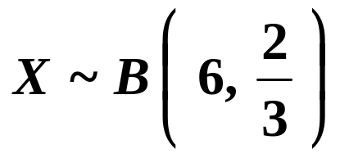
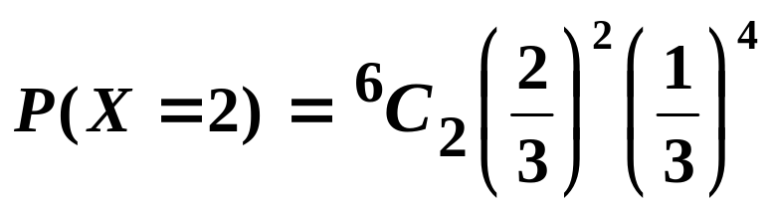



Exercise
1. A coin is biased so that a tail is twice as likely as a head. Find the probability that in 6 tosses, exactly 4 heads will be obtained.
Discussion:
There are 6 trials each with 2 outcomes. The trials are independent since one result does not affect another. The probability of success is constant. The Binomial is a good model.
Solution:
Let X be the r.v. “number of tails”
Then,
( If X counts heads, then p = and we need .)

Slide 12
Exercise
2. The proportion of a particular variety of seeds that fail to germinate is known to be 10%. If a random sample of 20 seeds is made, what is the probability that 2 or more fail to germinate?
Discussion:
There are a fixed number of trials, n = 20, and each trial has 2 outcomes; the seed does or does not germinate.
The probability of germination will be affected by the conditions in which the seeds are kept ( light, heat, moisture ) so p may not be constant and the trails may not be independent. However, if we assume care is taken with the experiment, we can use the Binomial model.

Slide 13


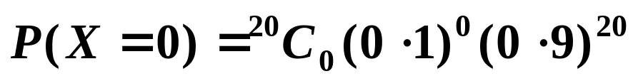


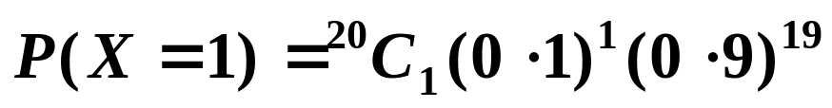

Exercise
2. The proportion of a particular variety of seeds that fail to germinate is known to be 10%. If a random sample of 20 seeds is made, what is the probability that 2 or more fail to germinate?
Solution:
Let X be the r.v. “number of seeds that fail to germinate”
Then,

Slide 14
Exercise
3. 20% of students travel to college by bus. If 15 students are chosen at random, what is the probability that fewer than 3 travel by bus?
Discussion:
There are 15 trials each with 2 outcomes. Since the students were chosen at random, the trials are independent.
However, the probability of a student travelling by bus is not constant. For example, some will be close enough to walk and others will be close to a train station, making the probability of using the bus very low. Those who live on a bus route would have a higher probability of travelling by bus.
The Binomial distribution is not a good model for this problem.

Slide 15


Slide 16
The following slides contain repeats of information on earlier slides, shown without colour, so that they can be printed and photocopied.
For most purposes the slides can be printed as “Handouts” with up to 6 slides per sheet.

Slide 17
SUMMARY
To determine whether the Binomial Distribution should be used to model a situation we do the following:
Look for a fixed number of trials.
Check whether each trial has 2 outcomes.
See if the probability of success is constant.
See if the trials are independent.
The last 2 conditions are the ones most likely not to be fulfilled.
To set up a solution:
Define a random variable, X.
Write down the distribution of X.

Slide 18
e.g. 1. A factory produces a particular type of computer chip. Over a long period the number that are defective has been found to be 15%. What is the probability that in a sample of 20 taken at random, 19 are perfect.
Are the conditions met for using the Binomial model?
A trial has 2 possible outcomes, success and failure.
Yes: Each chip is either defective or not.
The trial is repeated n times.
Yes: 20 chips are selected so n = 20.
The probability of success in one trial is p and p is constant for all the trials.
Yes: We are given 15% ( from which we can find p ) and we can assume it is constant.
The trials are independent.
Yes: The sample is randomly selected.

Slide 19

Solution:
Let X be the r.v. “ number of defective chips”
So,
The solution is now straightforward. We want .
I had set up the Binomial for the number of defective chips, because I had the proportion for defective. However, the question asked for the probability of 19 perfect ones.
If I had written
Let X be the r.v. “ number of perfect chips”
Then,
and I would want

Slide 20


e.g. 2. It is known that 60% of people cannot tell the difference between mineral and tap water. At a Maths Open Evening a random sample of 20 visitors were tested. What is the probability that at least 15 of them could identify the mineral water?
There are 30 trials and each has 2 possible outcomes.
It is reasonable to assume that the visitors have no special skills so p should be constant.
Provided the test is conducted carefully, one person will not be influenced by another so the trials will be independent.
The Binomial model can be used.
Solution:
Let X be the r.v. “ number identifying correctly”
So,
We want
Tables are needed to complete the calculation. We will see how to do this later.

Slide 21
e.g. 3. A salesman on average sells an expensive TV to 10% of customers. One Saturday 5 customers come in. Do you think the Binomial Distribution is a reasonable model to use to estimate the probabilities of sales? If so, calculate the probability that he makes exactly 1 sale. If you don’t think the Binomial is appropriate, say why not.
There are 5 trials so n = 5.
There are 2 outcomes to each trial; a sale or not.
However, it is very unlikely that the probability of success is constant. On a Saturday there could well be people looking around who have no intention of buying an expensive product.
The Binomial model should not be used.

